Slide 1
Financial Data and Stock Price Correlation
Jacob Kulik, David Pogrebitskiy
Notes:
J

Slide 2


OUR GROUP
Jacob Kulik
Data Science & Business Administration
Class of ‘25
David Pogrebitskiy
Data Science, Mathematics Minor
Class of ‘25
Notes:
Both

Slide 3
Statistical Question
1
Project Motivation
Notes:
D

Slide 4
How do various quantitative pieces of financial data affect and correlate with their company’s current share price?
Notes:
D

Slide 5
Company Introduction
2
Who We Analyzed and Why
Notes:
D

Slide 6


APPLE AND GOOGLE
We are analyzing the big tech industry because it is one that continues to grow and innovate whilst also carrying a fair amount of uncertainty.
Apple and Google are big players in the sector and actively compete in various products.
Notes:
D

Slide 7
Sourcing Data
3
Data Collection Process
Notes:
J

Slide 8

WHARTON RESEARCH DATA SERVICES
Using CompuStat from Wharton Research Data Services, we were able to access quarterly company filings for over 600 quantitative measures.
WRDS is a service that gives academic researchers access to accurate, reviewed data.
We exported this data from CompuStat in CSV format and converted into data frames.
Notes:
J

Slide 9
Ratio Introduction
4
What We Analyzed
Notes:
J

Slide 10
CORRELATION TO SHARE PRICE
Although a stock price simply represents the cost to purchase a singular share of a company, the price changes of that share price reflect the public’s opinion of the future success of the company.
Notes:
J

Slide 11
Graph Overview
5
How Displayed Results
Notes:
J

Slide 12
GRAPHING
Typical graphs contain the independent and dependent variables on the x and y-axes, respectively.
In our analyses, our dependent variable of stock price, however, will be on the x-axis as it is more correlated with time and creates a better visualization of the information.
Notes:
J

Slide 13
Current Ratio Analysis
6
Ability to Pay Off Short-term Debt
Notes:
J

Slide 14
CURRENT RATIO
Current Ratio =
Current Assets
Current Liabilities
The current ratio quantifies a company’s ability to pay for short-term debt using their current assets.
This typically reflects a company’s strategy with excess cash.
Notes:
J

Slide 15
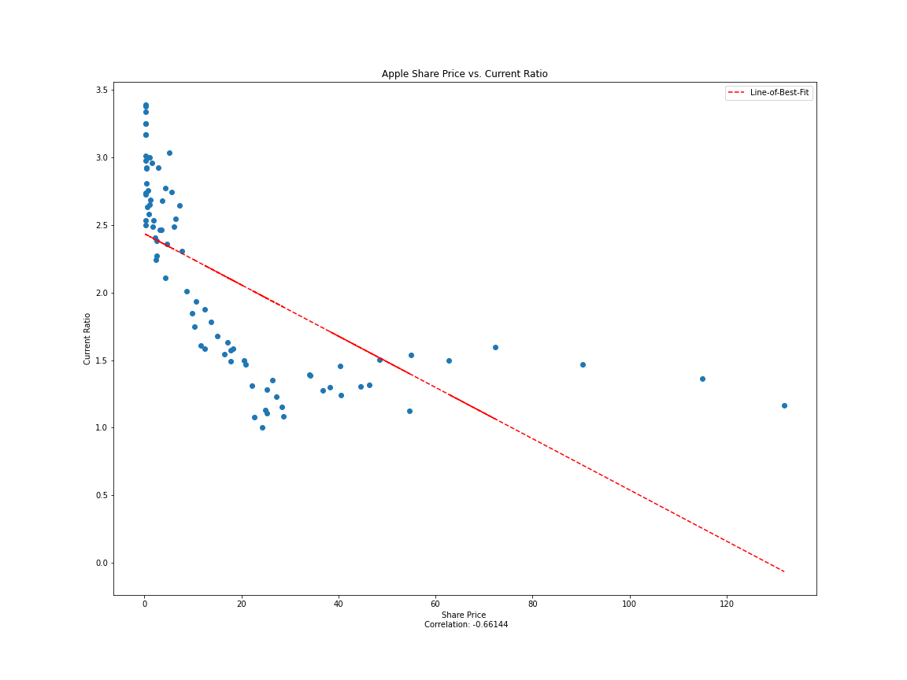
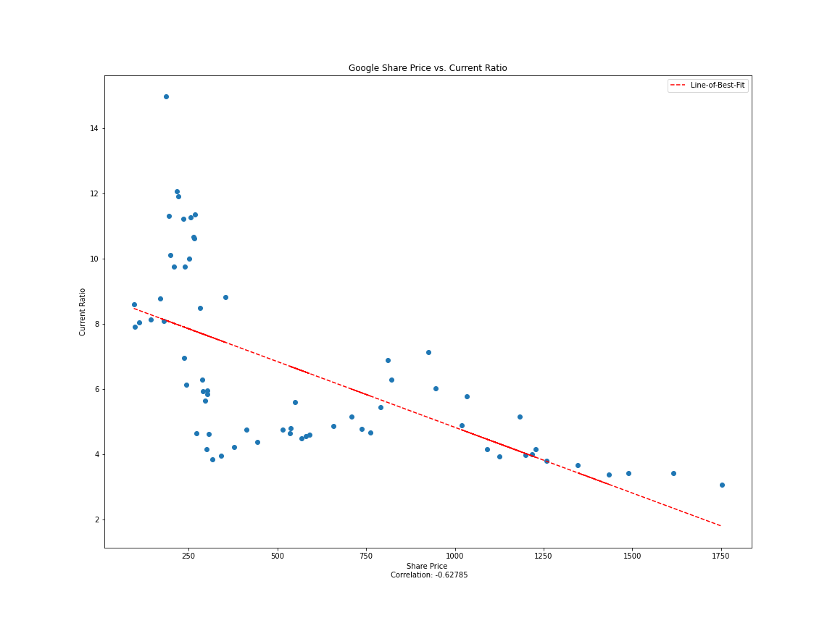
CURRENT RATIO GRAPHS
Correlation: -0.66144
Correlation: -0.62785
Notes:
J
Apple’s current ratio started very high representing lack of experience and a bad growth strategy. It began approaching 1 as Apple grew and realized that reinvesting excess cash is a better growth strategy.
The similar trend can be recognized in Google’s graph because they also became more experienced and started utilizing their excess cash.
An interesting note is that Google’s current ratio appears to be approaching 3 which means they have 3 times more liquid assets than short-term debts.

Slide 16
Return on Assets Analysis
7
Return on a Company’s Internal Investments
Notes:
J

Slide 17
RETURN ON ASSETS
ROA =
Net Income
Average Total Assets
The return on assets ratio highlights how effectively management was able to invest in assets to help produce a profit.
Makes companies of various sizes easily comparable.
Notes:
J

Slide 18
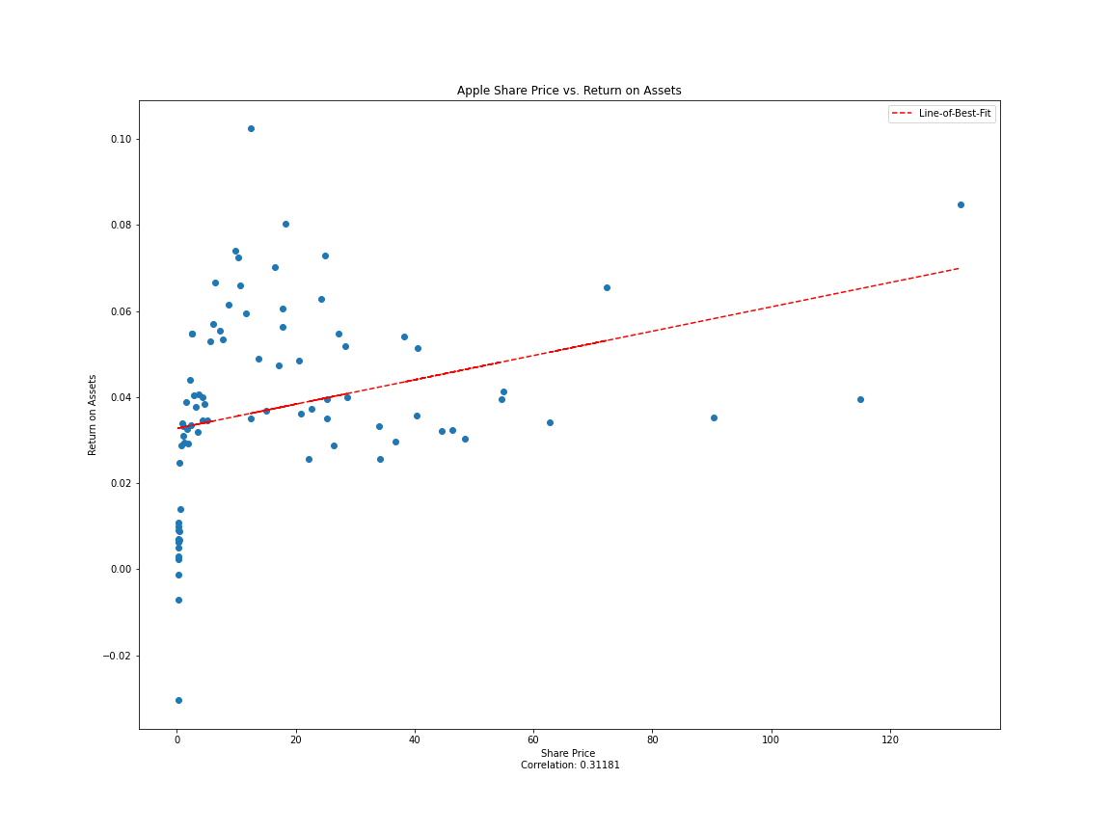
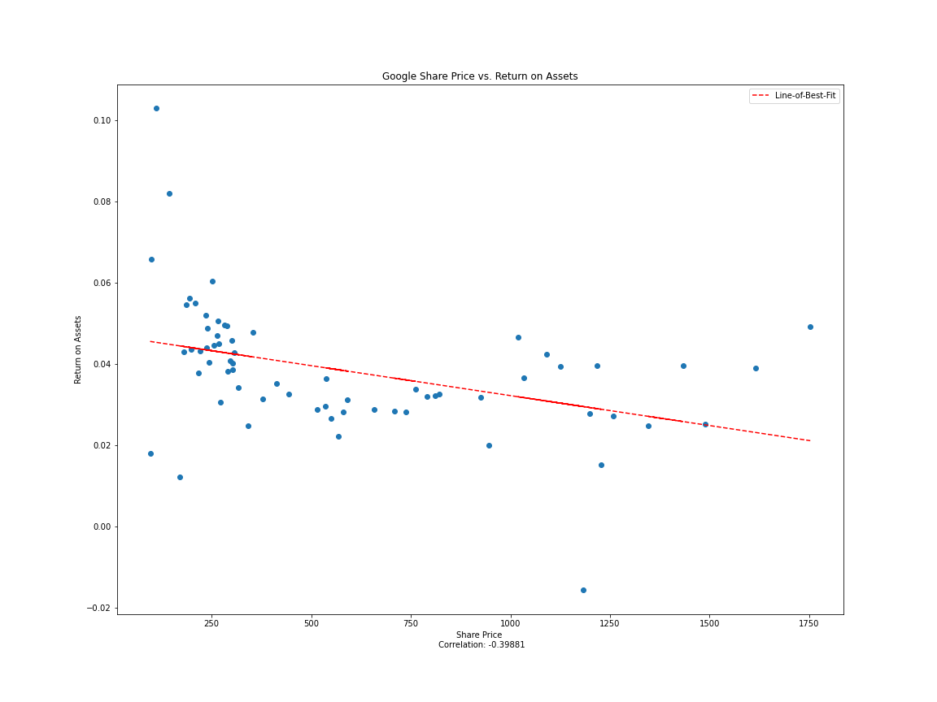
ROA GRAPHS
Correlation: 0.31181
Correlation: -0.39881
Notes:
J
It is interesting to note that both apple and google have ROA percentages above the IT industry average.
There is a weak correlation for both companies, but a slight upward trend for apple and slight downward trend for google.
Google’s negative trend makes sense in the context of their high liquidity and low efficiency

Slide 19
Return on Equity Analysis
8
Return on a Company’s External Investments
Notes:
J

Slide 20
RETURN ON EQUITY
ROE =
Net Income
Average Total Equity
The return on equity ratio conveys how a company generates profit from shareholders investments.
Notes:
J

Slide 21
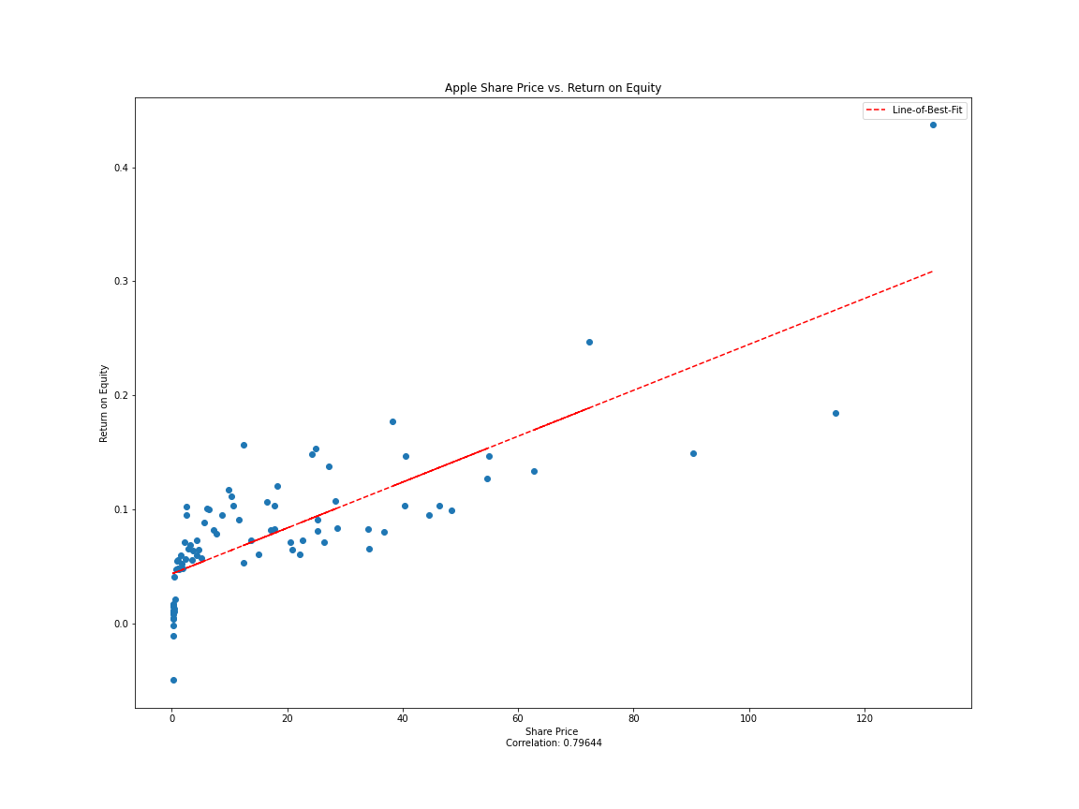
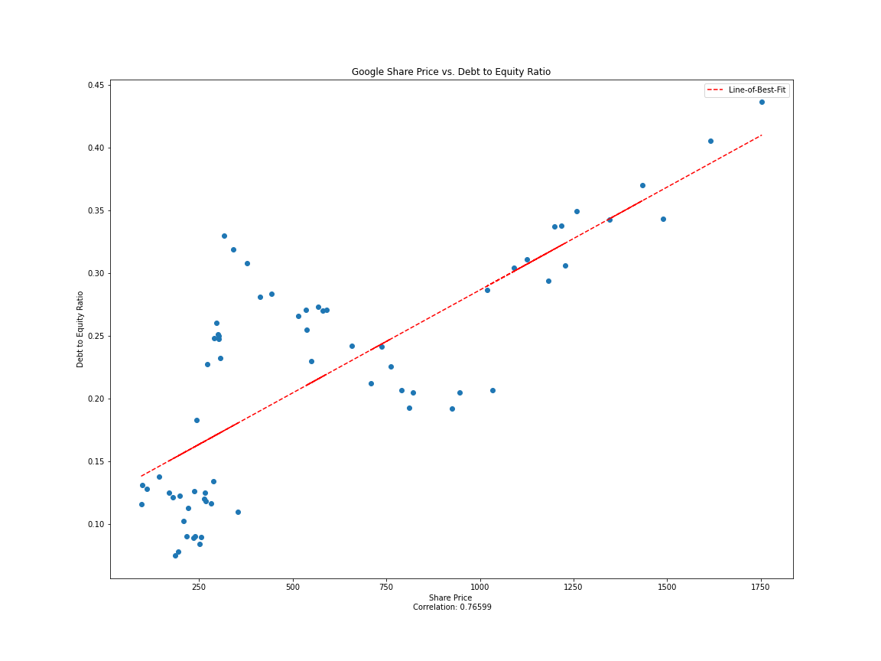
ROE GRAPHS
Correlation: 0.79644
Correlation: 0.76599
Notes:
J
ROE shows pretty strong positive correlations for both companies
Because the ratio highlights the ability to generate profit from equity, our graphs make sense as a higher stock price would most likely mean a higher return
Apple and Google both leverage equity to return a profit and as the companies grow, both ROE and stock price rise

Slide 22
Net Profit Margin Analysis
9
Ability to Generate Profit Compared to Net Sales
Notes:
D

Slide 23
NET PROFIT MARGIN
Net Profit Margin =
Net Income
Net Sales
The net profit margin represents the company’s ability to produce profit for every dollar of revenue.
Typically represented as a percentage, a higher net profit margin reflects better performance from the company.
Notes:
D

Slide 24
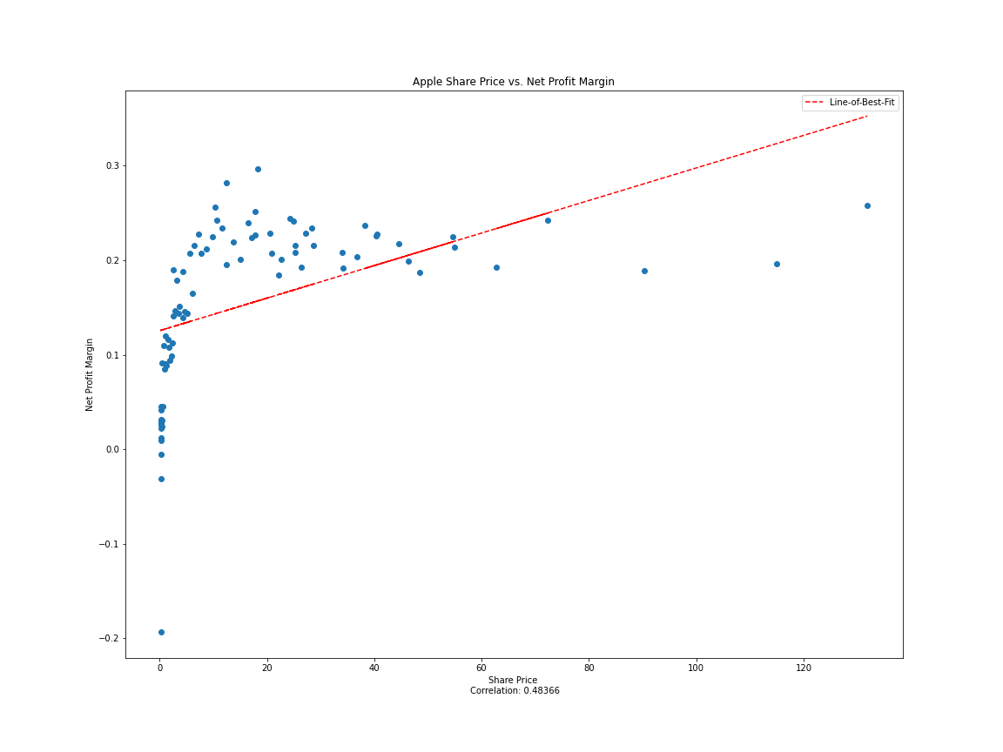
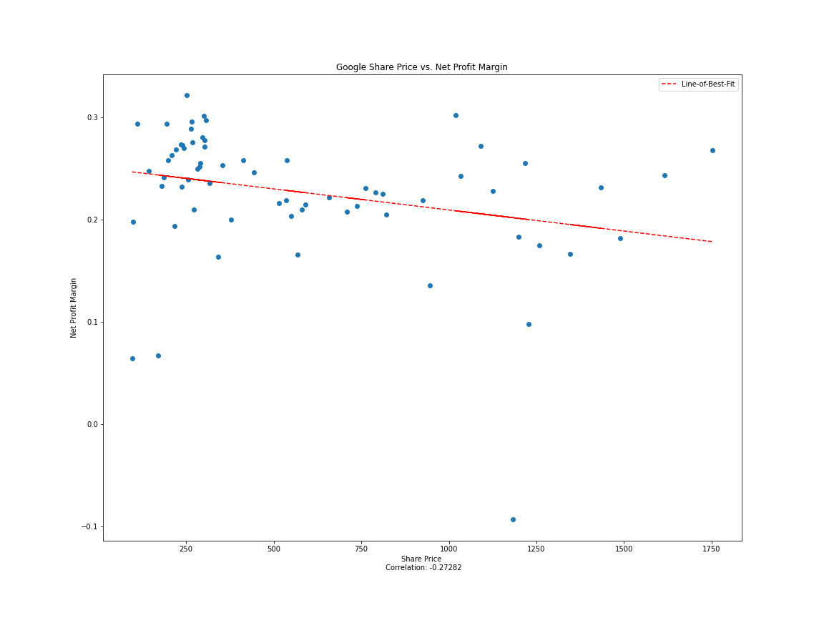
NPM GRAPHS
Correlation: 0.48366
Correlation: -0.27282
Notes:
D
You can see that Apple’s net profit margin trends upwards as they grew as a company because they found more efficient means of production which in turn reduced their costs of production.
Google’s NPM actually trends slightly downward. This can be explained by the fact that they were spending money on technology and companies that wouldn’t immediately provide a return on investment. Because most of Google’s revenue comes from ads, the ads made the same revenue while the company spent more money on long term investments. Examples include their acquisition of youtube as well as their expansion of cloud-based services that didn’t provide any additional revenue at the moment.

Slide 25
Debt to Equity Analysis
10
Extent of Reliance on External Creditors
Notes:
D

Slide 26
DEBT TO EQUITY
Debt to Equity =
Total Liabilities
Shareholder Equity
Represents how much a company relies on debt to operate the company.
A higher ratio can represent a higher risk to investors because the company is borrowing money that has to be repaid with interest.
A ratio between 0 and 1 means that the company is utilizing more financing from investors than from creditors.
Notes:
D

Slide 27
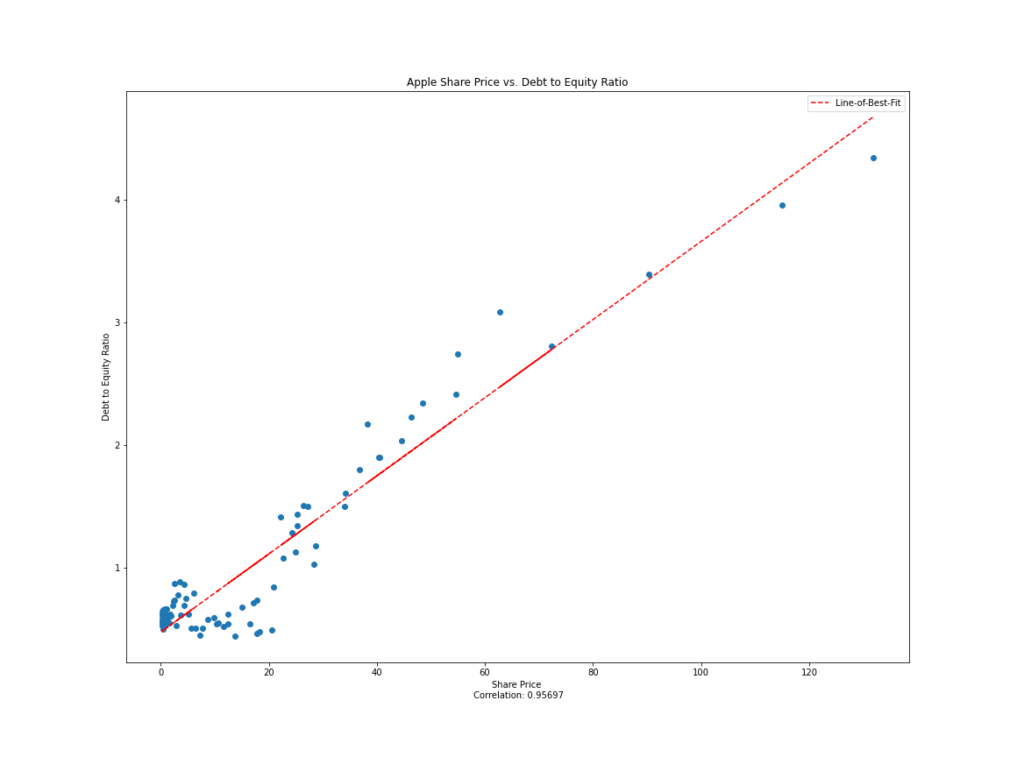
D2E GRAPHS
Correlation: 0.95697
Correlation: 0.76599
Notes:
D
You can see a strong correlation between the debt-to-equity ratios and the stock price.
This can be explained by the company getting more experienced and realizing that they’d rather accumulate debt than sell more shares of their company.
Both companies utilized investors more at the beginning of their lives but learned that debt is cheaper than equity in the long run so they’d rather take a loan than give investors shares.
Apple realiezd this pretty early on and now has 4x more debt than stockholders’ equity while Google still has more stockholders’ equity than debt.

Slide 28
Cash Flow to
Capital Expenditures Analysis
11
Ability to Purchase Long-term Assets Using Excess Cash Flow
Notes:
D

Slide 29
CASH FLOW TO CAPITAL EXPENDITURES
Cash Flow to CapEx =
Cash Flow
Capital Expenditures
CF to CapEx represents how easily a company can purchase long-term assets using excess cash flow.
A higher ratio generally shows a company is generating enough cash flow to begin investing in assets that will help long-term growth.
Notes:
D

Slide 30
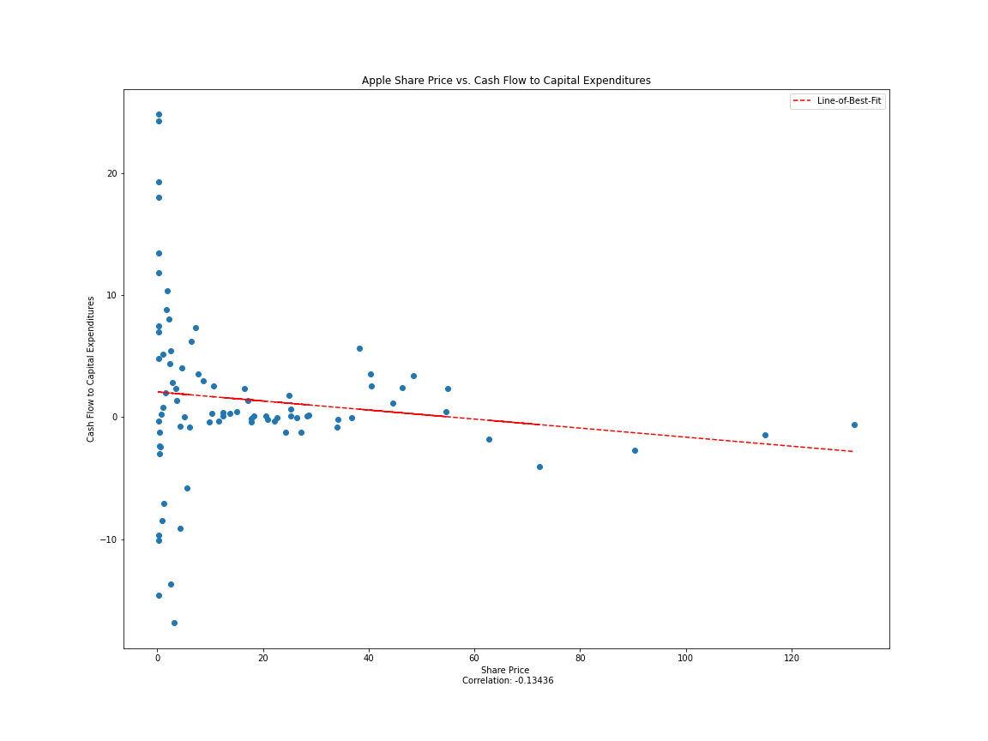
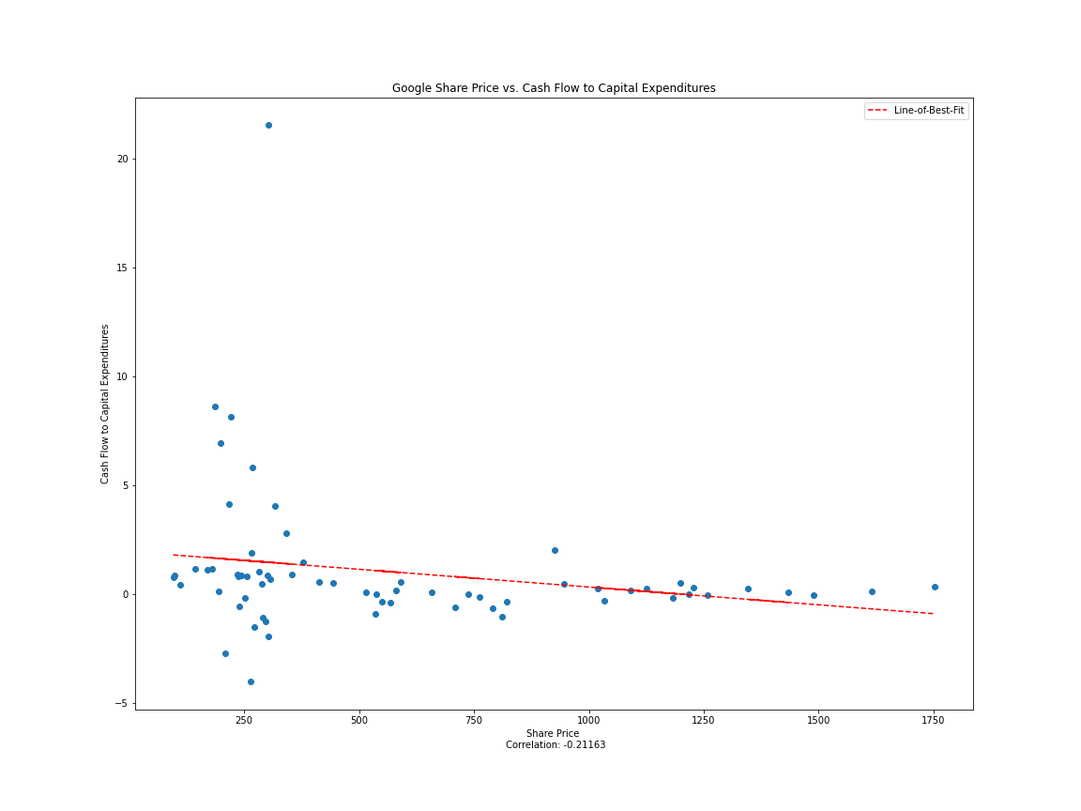
CF2CAPEX GRAPHS
Correlation: -0.13436
Correlation: -0.21163
Notes:
D
CF2CapEx is known to fluctuate due to periods of low and high capital expenditures.
It is interesting to note that the fluctuation slows down for both companies as time passes due to a solidification of strategy
Both companies contain a weak and slightly negative correlation, however it seems to remain asymptotic around 0 but still positive in recent years

Slide 31
Research and Development Analysis
12
Investments in Innovation
Notes:
D

Slide 32
RESEARCH AND DEVELOPMENT EXPENSE
Sum of expenses of innovative activities
R&D =
R&D is directly related to the company’s innovativity and future growth.
Although the effect of a company’s research isn’t directly material, it builds on its ownership of intellectual property.
Notes:
D

Slide 33
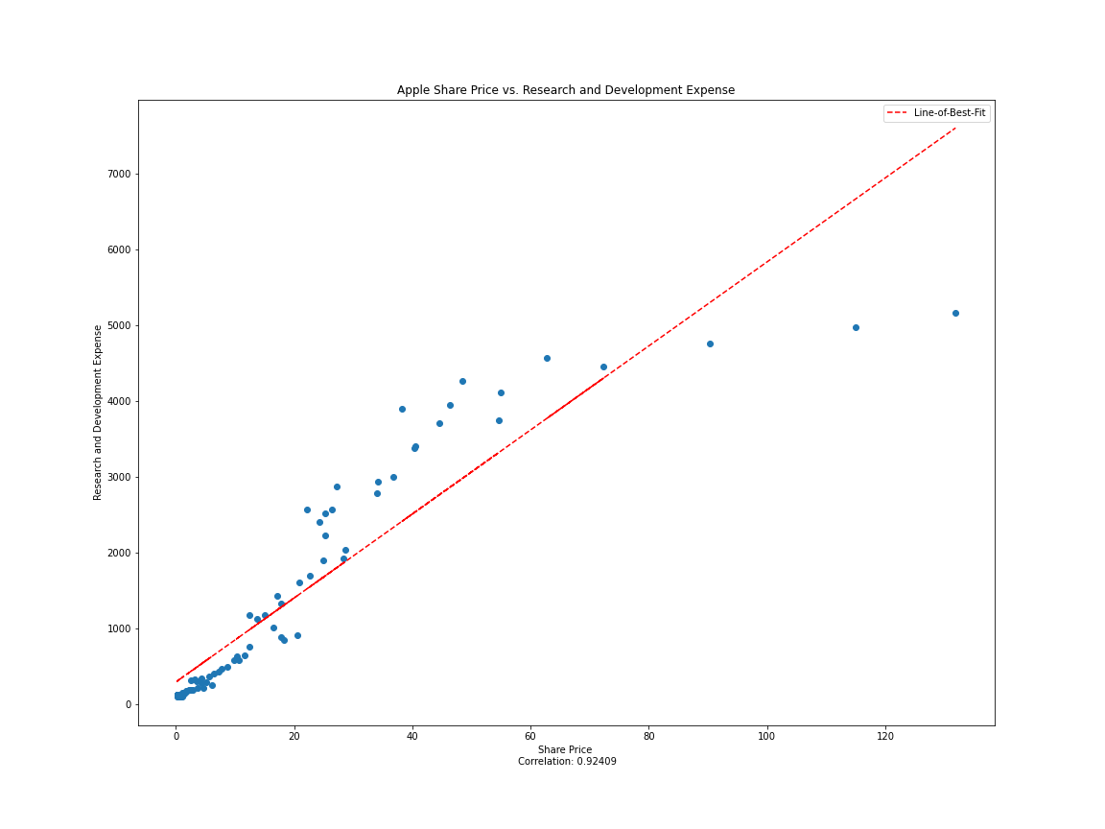
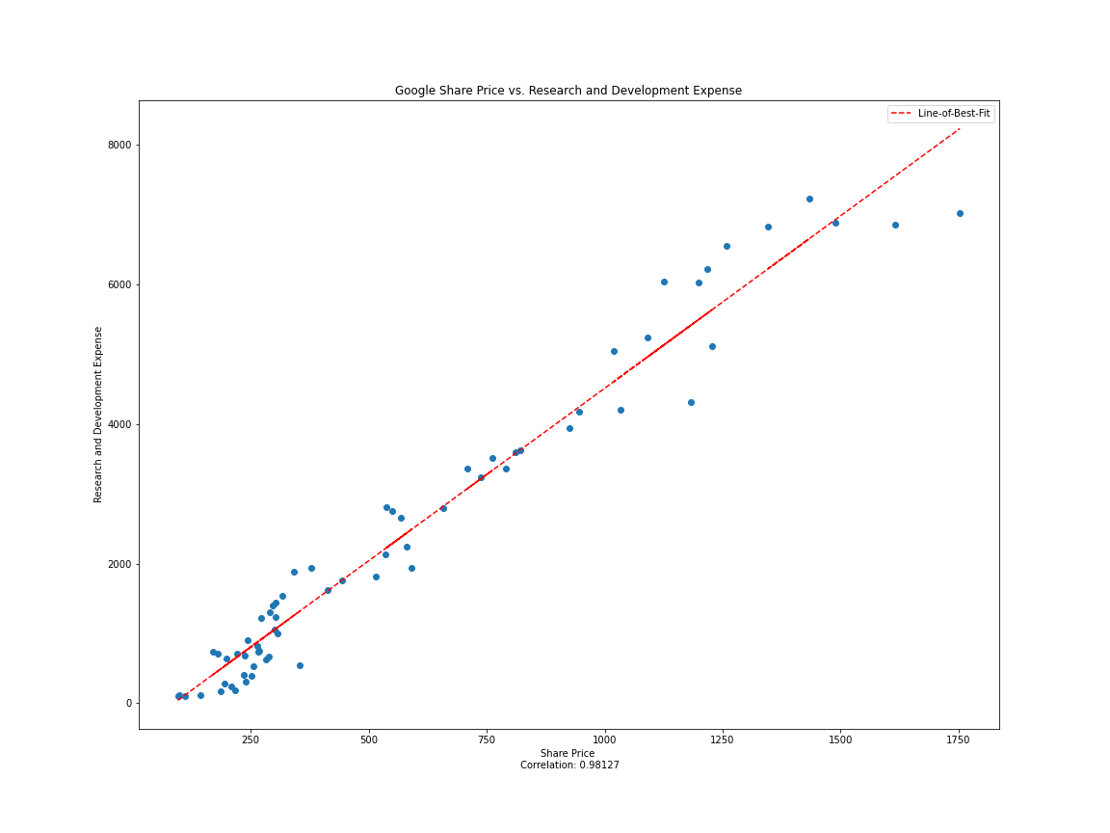
R&D GRAPHS
Correlation: 0.92409
Correlation: 0.98127
Notes:
D
R and D has a very strong correlation with stock price which is pretty self explanatory. Because stock price reflects how investors quantify a company’s worth and success, it makes sense that as a company spends more money on research and development, the value that they may be worth in the eyes of investors increases.

Slide 34
Summary of Findings
13
Notes:
J

Slide 35
SUMMARY OF FINDINGS
ROE, D2E, and R&D had strong, positive correlations
Current Ratio had an asymptotic negative correlations
ROA, NPM, and CF2CapEX had weak correlations
Notes:
J
As the company grows, the financial strategy improves and certain values, such as net income, directly impact ratios and stock price

Slide 36
Thank you!

